Slide 1
Plant desing drawings
PPRE Oldenburg University biogas compact course April 26 – 28, 2011

Slide 2
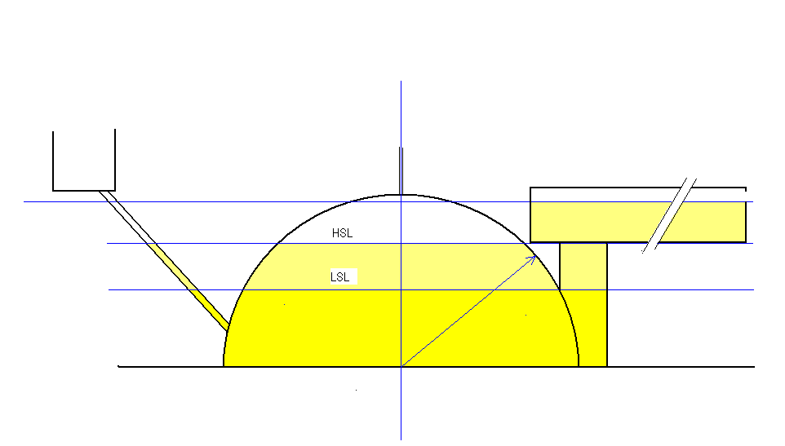
Plant lay out
Compensation volume
Gas storage volume
Digester volume

Slide 3
Dome radius
Dead volume
Gas storage volume
R dome
Digester volume

Slide 4
Digester volume dimensions
a
h
R dome

Slide 5
Gas storage volume dimensions
R2
h
R1

Slide 6
Overflow and pressure height
ph
oh
LSL

Slide 7
Compensation chamber dimensions
Rcc
Gas storage volume
cch
oh
HSL
Compensation volume

Slide 8
Inlet floor and inlet pipe
cch
ifh
oh
iph

